Slide 1
Regression Model Building 3: Model comparison
Michael Otterstatter
BCCDC Biostats Session
Aug 16, 2019

Slide 2
Session overview
In this session we will continue to discuss
key components in the model building process
models as a tool for exploring and describing data
And now focus our attention on
methods for comparing and selecting models

Slide 3
From last time…
Building a regression model requires careful thought throughout, not simply a ‘cookbook’ activity of following predefined steps
In general, you must consider and decide
What is the purpose of my model (describe, explain, predict)?
What type of model is appropriate for my purpose and data (ordinary linear, generalized linear, etc.)?
What is the best fit model for my data?

Slide 4
From last time…
Here we focus on descriptive modeling, which aims to
summarise or represent data in a compact manner
capture associations between dependent and independent variables
generate hypotheses (but not test hypotheses)
Different from
explanatory modeling: hypothesis testing - based on underlying causal theory
predictive modeling: model as a tool for predicting new observations

Slide 5
Our data
As an example, we consider individual-level clinic data from STI sentinel surveillance (provided by Clinical Prevention Services, BCCDC)
Chlamydia and gonorrhea diagnoses (2006-17) were linked to infectious syphilis diagnoses (up to 12-months after)
Patient-level information is based on case report forms and linkage to HIV surveillance data
Our interest is to describe the associations between syphilis diagnosis and the patient characteristics

Slide 6
Our data
Selected variables available for modeling building:
syph_dx - Patient had a syphilis diagnosis during the study period (yes/no)
earliest_age_grp - patient age groups (15-19, 20-24, 25-29, 30-39, 40-59, 60+ years)
hiv_atoc - Patient had HIV at the time of syphilis diagnosis (yes/no)
everlgv – diagnosis with Lymphogranuloma venereum anytime (lifetime or within study period)
gender_bin – Patient sex categories (M, F, NA)
surveillance_region_ha - Patient's Health Authority of residence
ctgc_cat - Number of chlamydia or gonorrhea diagnoses patient had during study period (1-2, 3-4, 5+)
post2011 - Chlamydia/gonorrhea diagnosis was after 2011 (yes/no)

Slide 7
Building a model
Although there are many approaches to model building, one always needs to
First, visualise the data: summary statistics, plots, etc.
Then, choose a candidate model (simple model, full model, etc.) as a starting point, assess fit, add or remove covariates
Then, compare the fit of candidate models against one another, by
generating predicted (‘fitted’) values or residuals (‘errors’) from the model and assessing relative fit
Examine ‘goodness-of-fit’ statistics (deviance, AIC, proportion variance explained, dispersion)

Slide 8
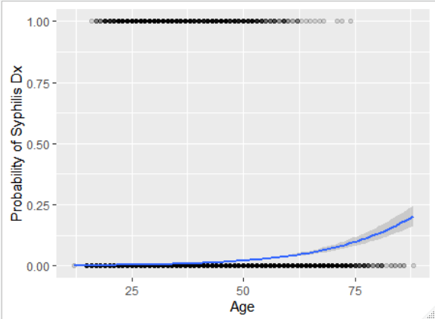
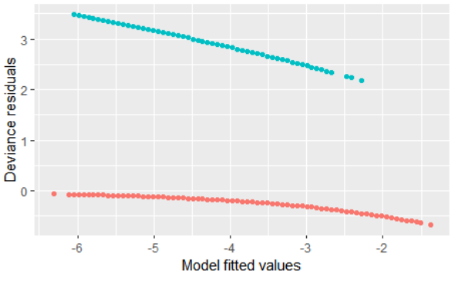
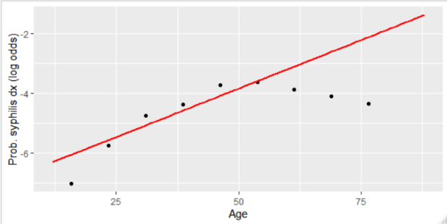
Model building: our starting model
We started with an age-only model
Prob(syphilis dx) = patient age
Then summarised model fit using residuals and deviance measures
But found this model only explained ≈6% of variation and assumption of linearity was questionable

Slide 9
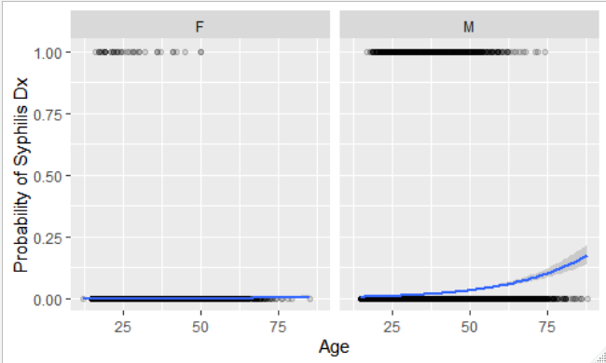
Model building: adding covariates
age by itself does not describe the probability of syphilis – let’s add covariates into our model
add sex: Prob(syphilis dx) = patient age + sex + age*sex

Slide 10
Compare fit of new model
Assess model fit: age and sex both appear as significant predictors, with higher probability of syphilis dx among men (but no interaction between age and sex)
Model with sex and age is a better fit than model with just age (significant reduction in deviance)
Coefficients:
Estimate Std. Error z value Pr(>|z|)
(Intercept) -8.22467 0.47722 -17.234 << 0.001 earliest_age_yrs 0.02373 0.01660 1.429 0.153
gender_binM 2.40398 0.48791 4.927 << 0.001 earliest_age_yrs:gender_binM 0.02491 0.01681 1.482 0.138
Deviance Resid.Df Resid.Dev Pr(>Chi)
NULL 132901 9938.7
earliest_age_yrs 553.54 132900 9385.1 << 0.001 gender_bin 859.73 132899 8525.4 << 0.001 earliest_age_yrs:gender_bin 2.45 132898 8523.0 0.1175

Slide 11
Compare fit of new model
Goodness-of-fit statistics also help compare models
Akaike information criterion (AIC)
Pseudo R² (Nagelkerke’s): Proportion of deviance explained by age + sex model is ≈14%, compared to only ≈6% for age-only model
> age_only_model$aic
[1] 9389.143
> age_sex_model$aic
[1] 8531.409
> age_sex_int_model$aic
[1] 8530.959
lower AIC, better model
similar AIC, similar models

Slide 12
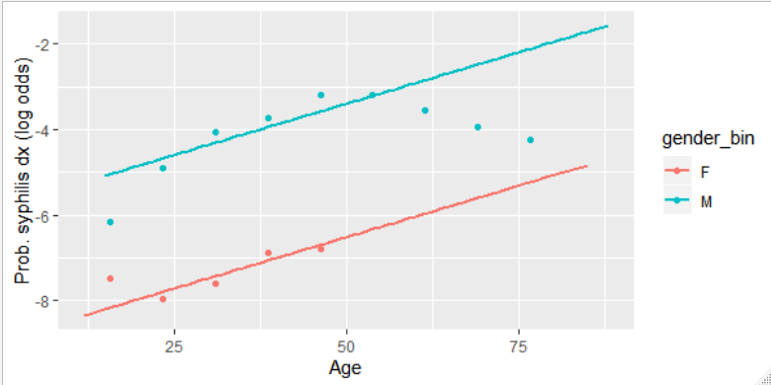
Compare fit of new model
Assess model assumptions: linearity still questionable

Slide 13
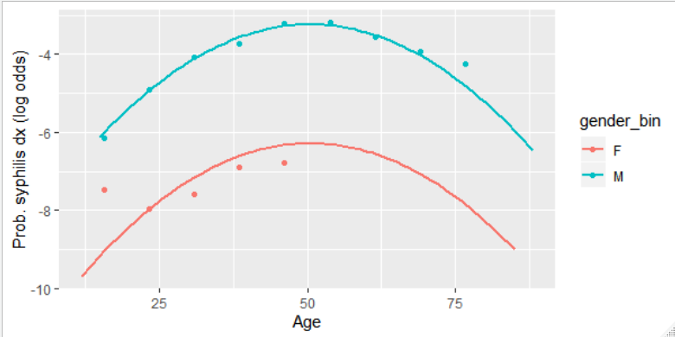
Compare fit of new model
By adding a quadratic term to our model, the fit with age is improved
Significant age² term (P << 0.001)
Overall reduction in model deviance (P << 0.001)
AIC is lower compared to age-sex model (8419 vs 8531)

Slide 14
Compare fit of new model
Other aspects of model assumptions/fit
In logistic and Poisson regression, we assume variance is proportional to the mean (deviance/df ≈ 1.0)
When data appear over- (dev/df >> 1) or under- (dev/df << 1) dispersed, SE values are likely too narrow and we should consider a ‘quasi’ model in which the dispersion factor is estimated from the data
# summary(age_sq_sex_model)
# ...
# Residual deviance: 8411.3 on 132898 degrees of freedom

Slide 15
Compare fit of new model
Fitting a ‘quasibinomial’ model only improves the estimates of the standard error, not the fit to the data per se
age_sq_sex_model <- glm(syph_dx ~ earliest_age_yrs + age_squared + gender_bin, family = "binomial", data = analysis_data)
Estimate Std. Error z value Pr(>|z|)
(Intercept) -12.1261140 0.3846859 -31.522 << 0.001 ***
earliest_age_yrs 0.2314716 0.0193865 11.940 << 0.001 ***
age_squared -0.0022917 0.0002459 -9.322 << 0.001 ***
gender_binM 3.0427839 0.1648438 18.459 << 0.001 ***
age_sq_sex_model_quasi <- glm(syph_dx ~ earliest_age_yrs + age_squared + gender_bin, family = "quasibinomial", data = analysis_data)
Estimate Std. Error t value Pr(>|t|)
(Intercept) -12.1261140 0.4393457 -27.600 << 0.001 ***
earliest_age_yrs 0.2314716 0.0221412 10.454 << 0.001 ***
age_squared -0.0022917 0.0002808 -8.162 << 0.001 ***
gender_binM 3.0427839 0.1882664 16.162 << 0.001 ***

Slide 16
Compare fit of several new models
Through this iterative process, we can build and compare a series of models – for each, we
assess fit to the data (generating model summaries and plots of predicted values and residuals)
compare to simpler models (using deviance reduction, % of variation explained, and goodness-of-fit statistics)
examine model assumptions and adjust as appropriate (e.g., quadratic terms with relations are non-linear)

Slide 17
Considering the full model
Starting with, or working our way up to, a full model will all (roughly 30) relevant covariates and interactions
we find many significant covariates (main effects and interaction terms
Full model explains ≈ 49% of variation in syphilis diagnosis
but also many terms (at least 12) that add little improvement to model fit

Slide 18
Considering the full model
Df Deviance Resid. Df Resid. Dev Pr(>Chi)
NULL 120594 7908.8
earliest_age_yrs 1 534.10 120593 7374.7 << 0.001
hiv_atoc 1 913.86 120592 6460.9 << 0.001
everlgv 1 133.19 120591 6327.7 << 0.001
gender_bin 1 551.08 120590 5776.6 << 0.001
surveillance_region_ha 4 225.97 120586 5550.6 << 0.001
TotalCTGC 1 844.96 120585 4705.7 << 0.001
post2011 1 225.86 120584 4479.8 << 0.001
age_squared 1 23.16 120583 4456.6 << 0.001
CTGC_squared 1 178.86 120582 4277.8 << 0.001
earliest_age:hiv_atoc 1 8.19 120581 4269.6 0.0042111
earliest_age:everlgv 1 0.92 120580 4268.7 0.3384752
earliest_age:gender_bin 1 6.67 120579 4262.0 0.0097825
earliest_age:surv_region 4 4.62 120575 4257.4 0.3288628
earliest_age:TotalCTGC 1 7.49 120574 4249.9 0.0062037
earliest_age:post2011 1 3.51 120573 4246.4 0.0609164
hiv_atoc:everlgv 1 18.08 120572 4228.3 << 0.001
hiv_atoc:gender 1 0.02 120571 4228.3 0.8783368
hiv_atoc:surveillance_region 4 11.76 120567 4216.5 0.0192030
hiv_atoc:CTGC 1 7.20 120566 4209.3 0.0072782
hiv_atoc:post2011 1 0.00 120565 4209.3 0.9602960
everlgv:gender 1 0.08 120564 4209.2 0.7745739
everlgv:surveillance_region 3 17.37 120561 4191.9 0.0005944
everlgv:CTGC 1 0.96 120560 4190.9 0.3273099
everlgv:post2011 1 0.40 120559 4190.5 0.5258297
gender_bin:surv_region 4 3.60 120555 4186.9 0.4631156
gender_bin:CTGC 1 1.19 120554 4185.7 0.2754139
gender_bin:post2011 1 43.38 120553 4142.3 << 0.001
surveillance_region_ha:CTGC 4 5.93 120549 4136.4 0.2044090
surveillance_region:post2011 4 3.13 120545 4133.3 0.5361186
TotalCTGC:post2011 1 27.72 120544 4105.6 << 0.001

Slide 19
Considering a reduced model
We could manually prune the full model to include only those terms adding significant improvement to model fit
In this way, the reduced model has half as many covariates (17) as full model but still explains the same amount of variation in syphilis dx (~49%)

Slide 20
Considering a reduced model
Df Deviance Resid. Df Resid. Dev P(>Chi)
NULL 120594 7908.8
earliest_age_yrs 1 534.10 120593 7374.7 << 0.001
hiv_atoc 1 913.86 120592 6460.9 << 0.001
everlgv 1 133.19 120591 6327.7 << 0.001
gender_bin 1 551.08 120590 5776.6 << 0.001
surveillance_region_ha 4 225.97 120586 5550.6 << 0.001
TotalCTGC 1 844.96 120585 4705.7 << 0.001
post2011 1 225.86 120584 4479.8 << 0.001
age_squared 1 23.16 120583 4456 << 0.001
CTGC_squared 1 178.86 120582 4277.8 << 0.001
earliest_age_yrs:hiv_atoc 1 8.19 120581 4269 0.0042111
earliest_age_yrs:gender 1 6.50 120580 4263.1 0.0107726
hiv_atoc:everlgv 1 18.73 120579 4244.4 << 0.001
hiv_atoc:surv_region 4 12.04 120575 4232.3 0.0170443
hiv_atoc:TotalCTGC 1 10.11 120574 4222.2 0.0014774
everlgv:surveillance_region 3 17.38 120571 4204.8 << 0.001
gender_bin:post2011 1 31.78 120570 4173.1 << 0.001
TotalCTGC:post2011 1 33.46 120569 4139.6 << 0.001

Slide 21
Next time…
We can talk more about variable selection and automated vs manual approaches to model building

